Slide 1
DATA STORYTELLING & STATISTICAL VALIDATION
CAFE SALES ANALYSIS PROJECT

Slide 2
PROJECT OBJECTIVE
The objective of this project was to analyze café sales data
Also clean inconsistencies in the dataset, identify business trends
And create interactive dashboards, and provide actionable insights.
To improve sales performance and customer satisfaction.

Slide 3
DATASET OVERVIEW
Dataset Name : Dirty Café Sales
The dataset contains information related to:
Product sales
Quantity sold
Location
Customer Transaction
Payment Methods
Sales Dates
The dataset initially contained inconsistencies and missing values which were corrected during the data cleaning process.

Slide 4
Data Cleaning Summary
The following data cleaning activities were performed:
Missing values identified and handled
Duplicate records checked and removed
Incorrect data formats corrected
Data consistency improved
Dataset transformed into a clean and reliable format
Result:
The dataset became suitable for analysis and visualization.

Slide 5
EXPLORATORY DATA ANALYSIS
Key Findings from EDA :
Customers belong to a wide range of age groups.
Female customers make more purchases than male customers.
Most purchases are low to moderate in value.
Age has little impact on spending behavior.
Quantity and price show a moderate positive relationship.

Slide 6
SQL ANALYSIS INSIGHTS
SQL Queries were used to analyze:
Total revenue
Best selling products
Product wise sales performance
Customer transaction patterns
Revenue distribution
The analysis helped identify products that contributed most to café revenue.

Slide 7
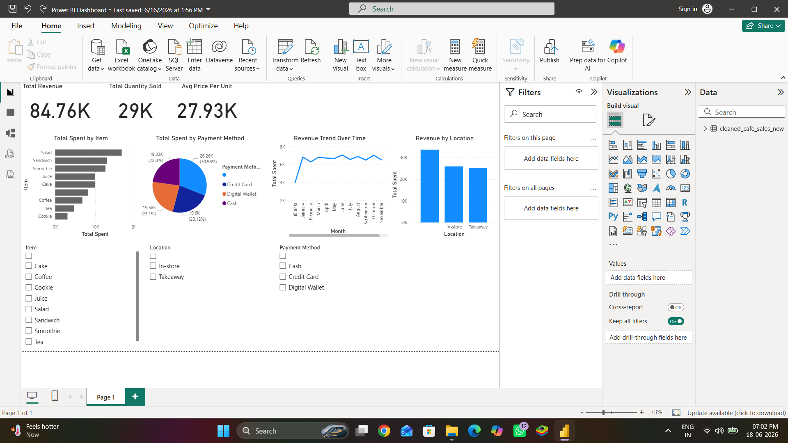
DASHBOARD HIGHLIGHTS
Revenue monitoring
Product performance analysis
Sales trend visualization
Interactive filters
Business performance tracking
The dashboard enables quick decision making through visual insights.

Slide 8
business Recommendations
Increase promotion of top-selling products.
Improve visibility of high-profit items.
Optimize inventory based on demand trends.
Focus marketing efforts on popular product categories.
Monitor sales regularly using dashboards.

Slide 9
conclusion
The Dirty Cafe Sales dataset was successfully cleaned, analyzed, and transformed into meaningful business insights. Through data cleaning, SQL analysis, dashboard creation, and statistical validation, valuable recommendations were identified to support business growth and better decision-making.

Slide 10
Thank you

